Slide 1
JNCIS-ENT
Layer 2 switching and VLANs

Slide 2
Switching and Bridging Components
1
Shared LAN vs. Switched LAN

Slide 3
Shared LAN vs. Switched LAN
A shared LAN uses a Hub which connects all devices to a single collision domain
All traffic in a collision domain is seen by all other devices in the collision domain
Hub

Slide 4
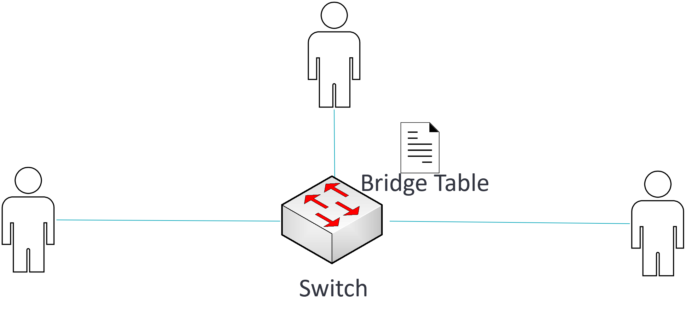
Shared LAN vs. Switched LAN
In a switched or bridged LAN, traffic is forwarded based on the bridging table
Each port on a switch or bridge is its own collision domain
Intelligent forwarding decisions are made based on bridge table

Slide 5
Bridging Mechanisms
Bridging allows a mixed series of interfaces types and speeds to be logically grouped
Bridging builds and maintains a bridge table using the following mechanisms
Learning
Forwarding
Flooding
Filtering
Aging

